Slide 1
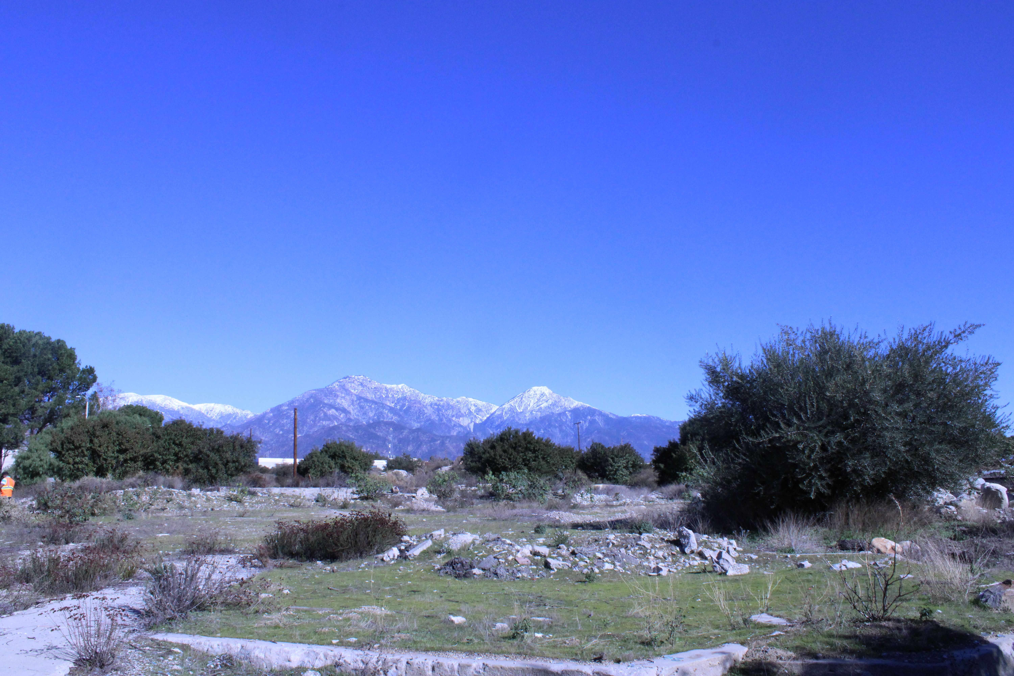
IST303 Fall 2022
The Dream Team
Hunter Sayre
Javier Aguilar
Katie Enns
Pankaj Chaudhari
“claremont-presents.com”
Final Presentation
Notes:
Add Date?

Slide 2

Presentation Outline
1) Project Summary
Overview, Milestone 1, Milestone 2, Burndown Chart
2) Milestone 2 User Stories
3) Demonstration
4) Testing Strategies
5) Reflections
Notes:
Running & Testing the application, and Reporting Testing Coverage
Divide into 4 parts
1) summarize bullet points
2) For User Stories, Grey out 6/8 and highight and bold last 2 Userstories
- the last 2 user stories were more complicated. This is why, etc.
3)

Slide 3
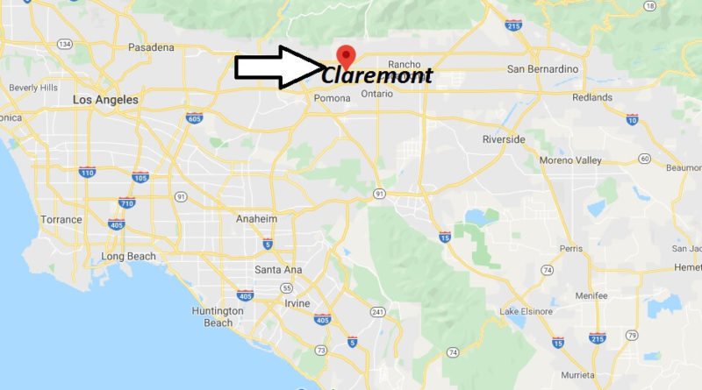

Project Motivations & Overview
1)
Claremont has a lot to offer!
Claremont has many local residents and frequent visitors
Claremont is in a large metropolitan area
The large student body of the 7C’s, many of us coming from different areas, arrive less familiar with Claremont
Students would be benefitted by a centralized and efficient resource that presents what's available to do, and where, in the city of Claremont = claremonts-presents.com !
Notes:
The reason the Dream Team decided this application should be created is because Claremont is a part of all our day-to-day lives through CGU, so it is practical to want to know the Claremont area better as to be able to enjoy everything it has to offer
STAKEHOLDERS: Everyone in Claremont benefits: users of the app learn more about what there is to do around them, and local businesses and parks, etc, see more customers / visitors as a result.

Slide 4
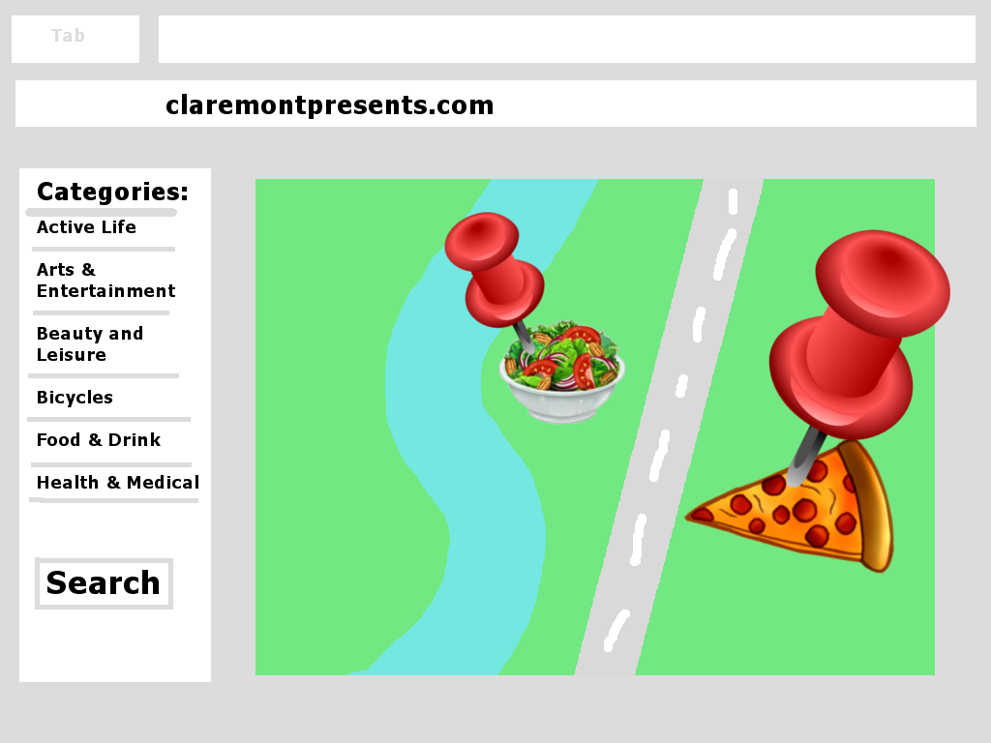

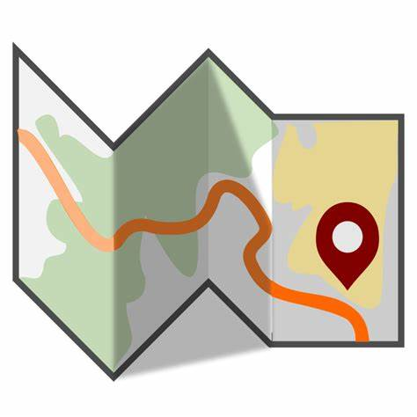
claremont-presents.com an application
1)
A responsive web-based GIS application that presents users with an interface to select different life-style categories with the ability to search for place-based activities within those fields
We also wanted this application to have admin functionalities to enable altering of the application

Slide 5
Project Source
1)
Link to our Github:
https://github.com/katieenns/Dream-Team
Link to our Issues:
https://github.com/katieenns/Dream-Team/issues
Link to our Project Dashboard:
https://github.com/users/katieenns/projects/1

Slide 6
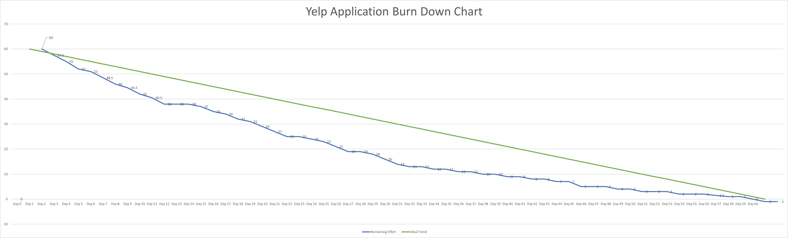

1)
Development Status & Timeline
Milestone 1
Finished
Milestone 2
Start
Project Completed
60 Total Days Current Velocity 100%
1 Dream 2 Milestones 8 User Stories 17 Tasks 23 Issues

Slide 7





Technology Stack
1)
HTML, CSS (GUI Development)
Bootstrap (GUI Development)
Esri Calcite (GUI Development)
JavaScript (Frontend Scripting)
Esri ArcGIS JavaScript API (Frontend Scripting)
Flask (Web application framework)
Pytest (Unit testing)
API's
ArcGIS BaseMAP
ArcGIS Geocoding
YELP
SQLite (Filesystem database)
Notes:
Stayed the same

Slide 8
1)
To be able to see a website which has map on home page, and it's zoom to Claremont city by default and have ability to search required location.
The website to be responsive. It must be rendered properly on desktop and mobile devices properly.
To be able to move around the map (zoom in and out) and see different types of maps and change settings of website/application to see it in different themes. User shall not be able zoom out beyond USA country.
Select specific categories and related multiple subcategories. User wants to able to specify the radius within which specific categories can be located. Application must use YELP search API in backend to query the information related to categories of interest.
To browse through all search results on map and shall be able to retrieve more information by clicking on specific search result on map.
To see additional information like rating, distance etc. for all search results from specified search location.
Admin user wants to be able to login into website to view admin dashboard.
Admin user wants to know which filters are selected most often and be able to modify category and sub-categories.
Milestone 1
Milestone 2
~(REFACTORING)~
Notes:
Thoughts on Refactoring, do we discuss this at all in presentation?

Slide 9
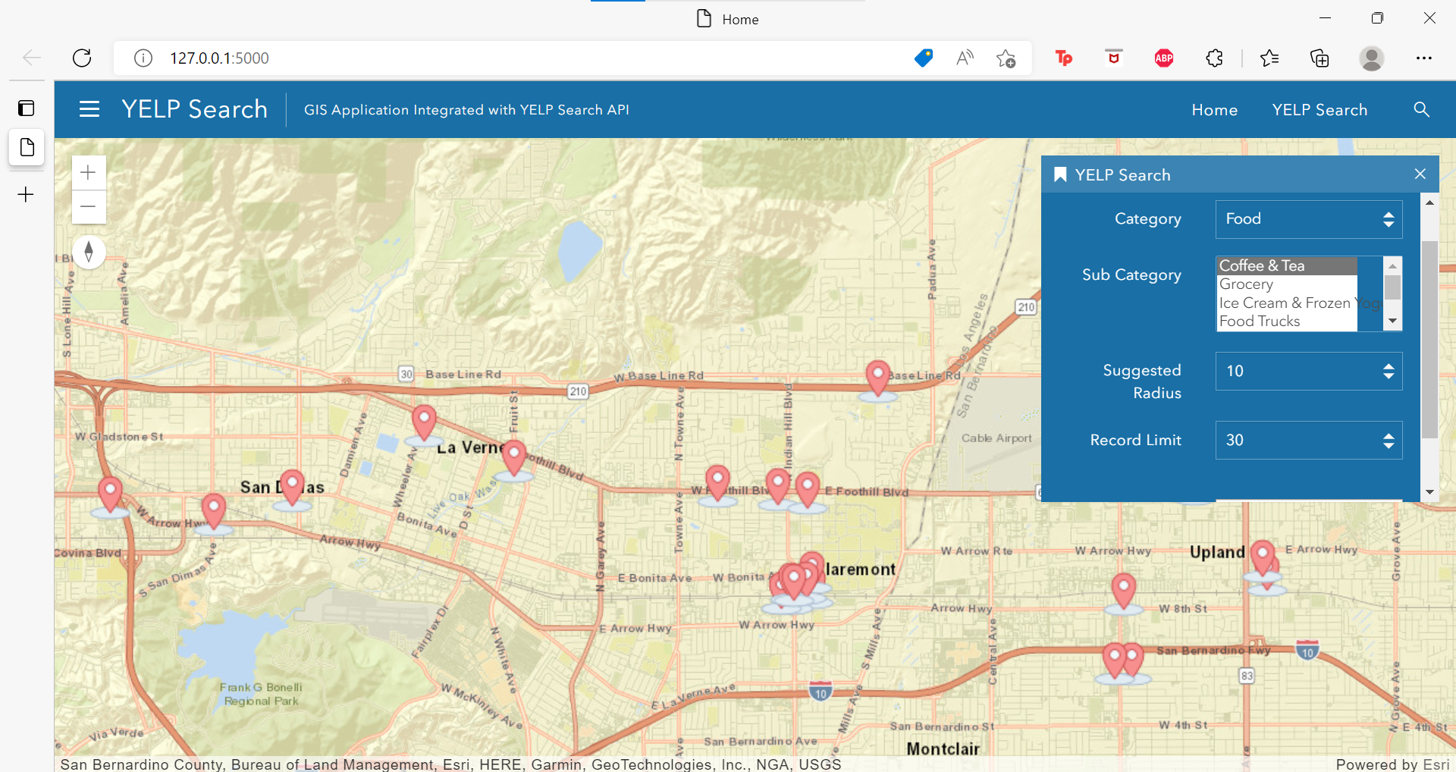
Milestone 1
1)

Slide 10
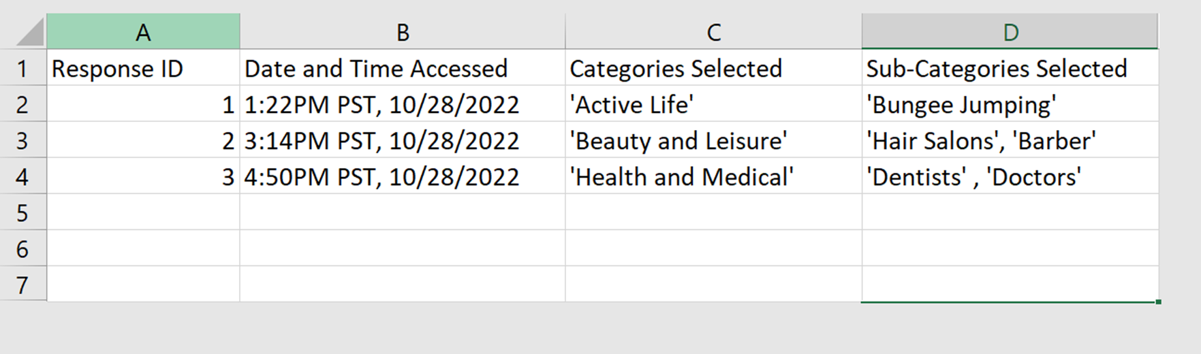
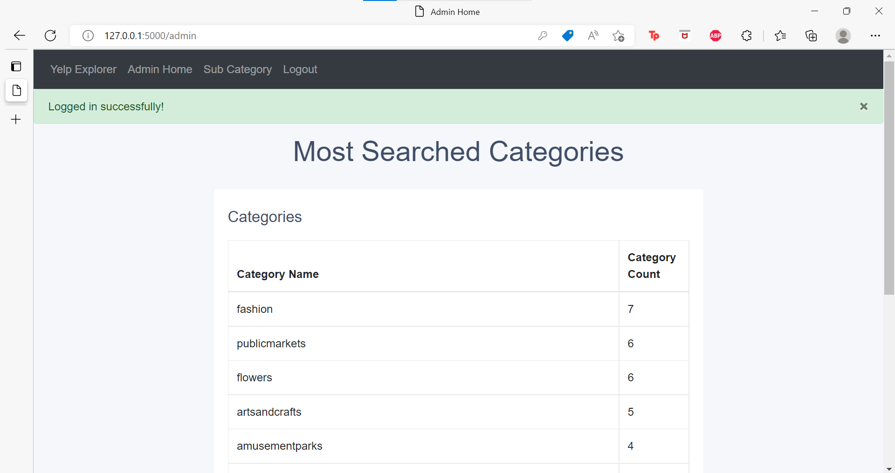
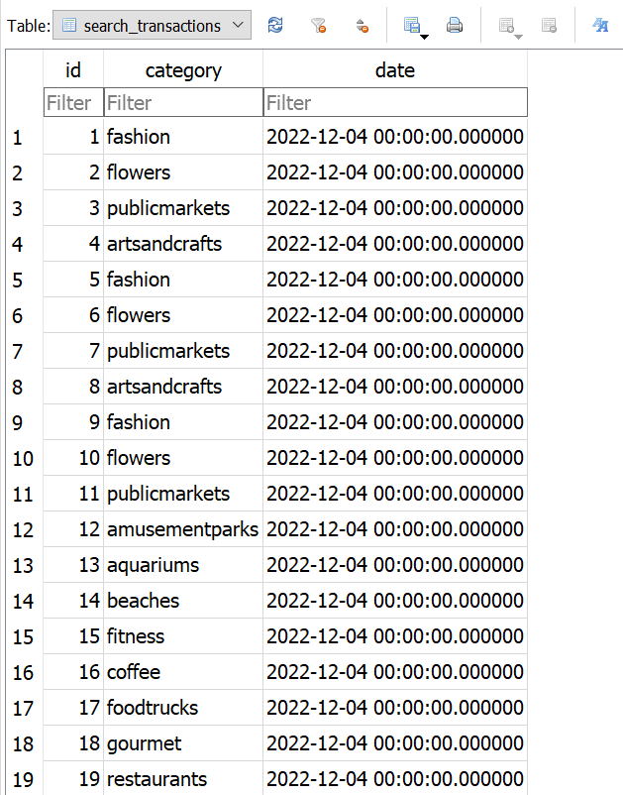
Milestone 2 Database and Admin Controls / Coding
2)
From Prototype!
To Product!
Notes:
Add Log-in Screenshots

Slide 11
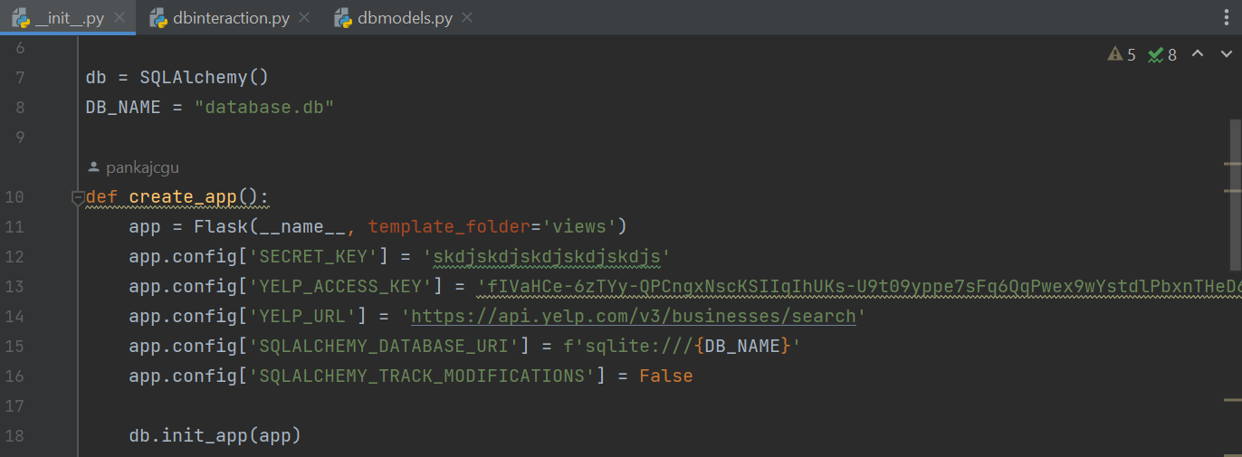
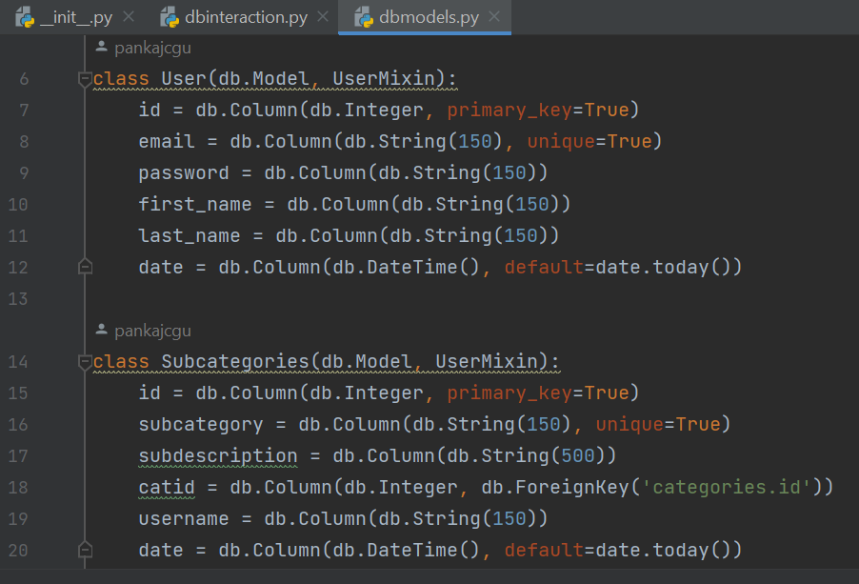
Milestone 2 DB Code Example
2)
Process:
Initialize DB, Check if DB exists,
Create Classes for Tables,
Create Database Interaction / Connections
Database Tables:
Categories
Subcategories
User
Search Transactions
Notes:
From init.py
Add Admin Homepage that shows most searched categories (prntscreen)

Slide 12
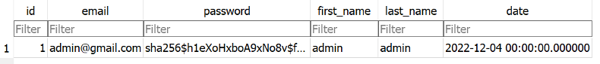
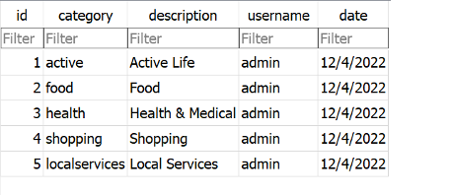
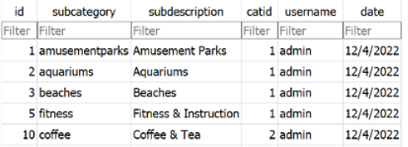
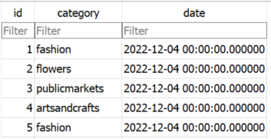
Milestone 2 - Database Table Relationships
2)
Users
Categories
Subcategories
Search Transactions

Slide 13
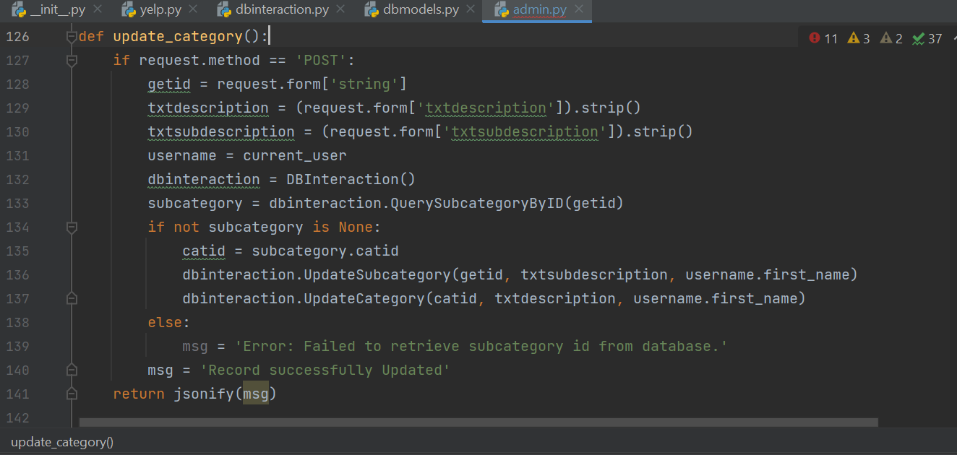
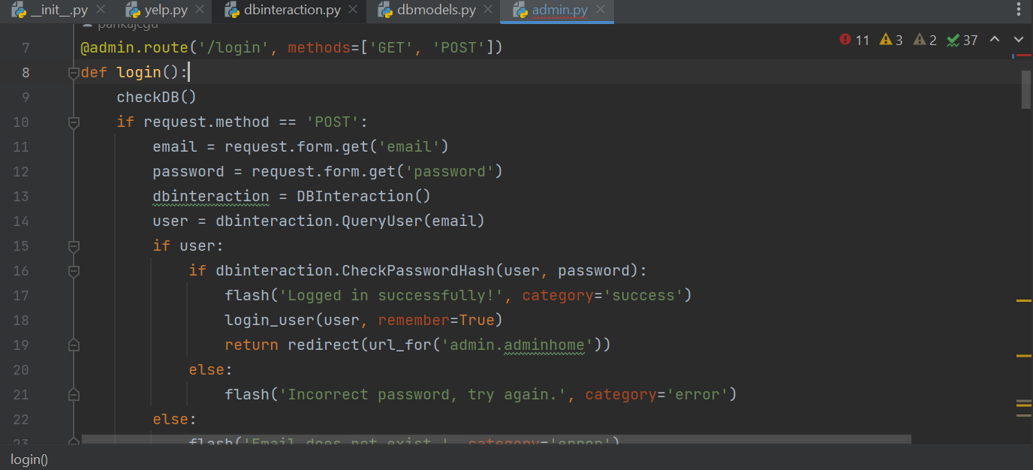
Milestone 2 Admin Code Example
Update Function
2)
Login Function
Admin Abilities:
Login to Admin Role
Query Databases
Add Categories
Update Categories
Delete Categories

Slide 14
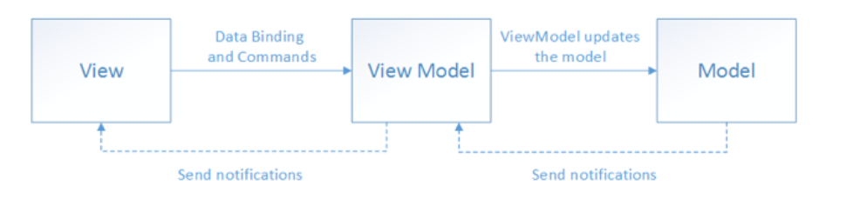
Code Refactoring
2)
Between Milestone 1 and Milestone 2, (and as a result of many failed attempts to connect a database) we refactored our code
Adopted a 'Model View ViewModel' Architecture also known as MVVM
Notes:
Place Holders, feel free to edit / remove graphics in this slide

Slide 15
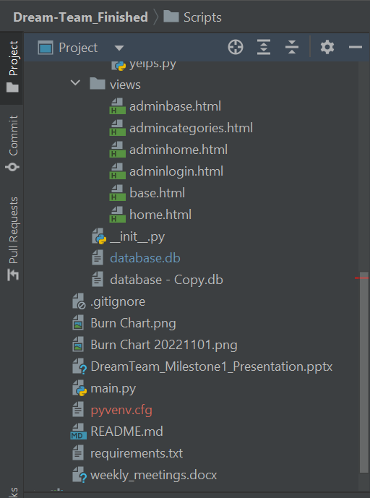
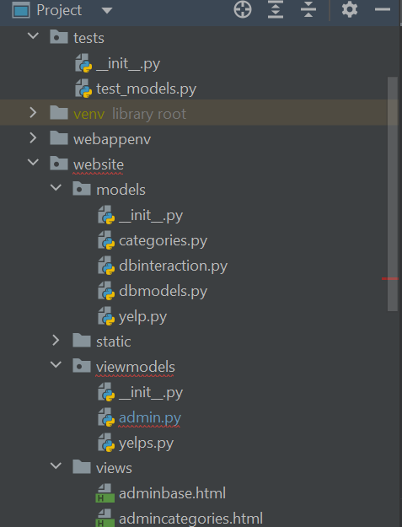
Coding Structure
2)
Core Application Modules
1) Yelp Module
2) Website Framework
-User Webpages
-Admin Dashboard
3) Map Module
4) Database Module
Notes:
Place Holders, feel free to edit / remove graphics in this slide

Slide 16
Application & Tests Demonstration http://127.0.0.1:5000 (holding site for claremont-presents.com)
3)
Notes:
Live Walk-Through of an example User Experience

Slide 17
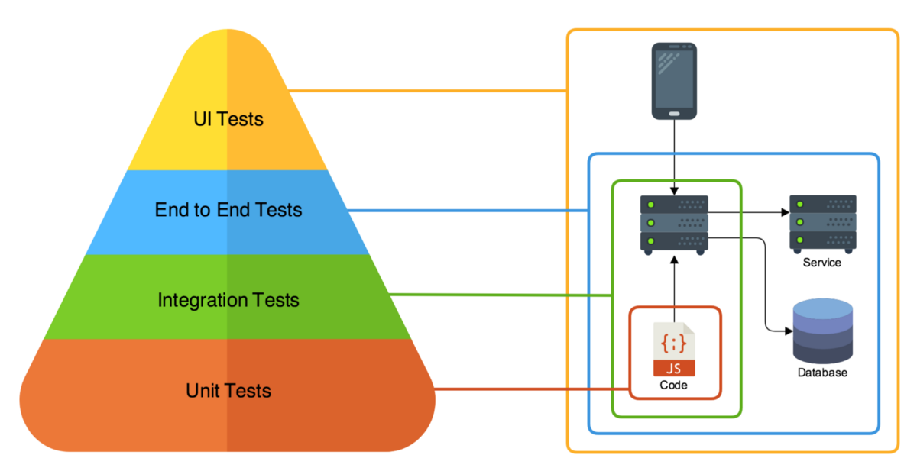
Testing Strategies
4)
Unit Testing
Functional Testing
Manual Testing
Notes:
Place Holders, feel free to edit / remove graphics in this slide

Slide 18
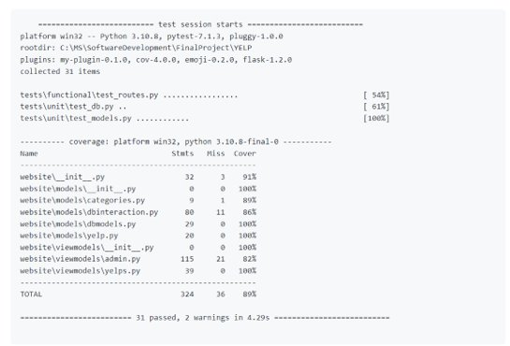
Testing Coverage
4)
324 of 360 statements
Covered.
Total Coverage = 89%

Slide 19
Claremont-Presents What We Learned
5)
1) We learned how to integrate GIS mapping / APIs with Python and Flask plugins to create a web-based GIS Application.
2) Different testing frameworks, including pytest unit testing and pytest-flask functional testing. Test driven development is extremely beneficial as it hard to write tests for code after it is written
3) Modularizing the codebase to follow best coding practices architecture.
Notes:
How we integrated Python with GIS application and Flask plugin
1) We learned how to integrate GIS mapping / APIs with Python and Flask plugin's to create a web based GIS Application.
2) We learned how to implement different testing frameworks, including unit testing and effective py-testing. In doing so, we learned that test driven development is extremely beneficial as it hard to write tests for code after it is written
Subscribe to Agile Methodologies and utilize online resources (eg. Stack OverFlow); and know there are many ways to do the same thing!
This needs editing
1) Subscribe to Agile Methodologies and utilize amazing online resources (Stack OverFlow)
2) Understanding how to use GitHub is important
3) Development of projects does not always go exactly as planned (maybe delete this one since ours was mostly successful lol but we still had bumps)
4) Test driven development is extremely beneficial (writing tests after code is hard)

Slide 20
Claremont-Presents Next Steps
5)
Purchase Domain Name
Claremont-Presents.com
Application and Database Security optimization
Advertise Product & Collaborate with the Claremont Colleges
Continue being Lifetime Learners
Notes:
This needs editing

Slide 21
Questions?
Thanks for listening!!!

